Slide 2


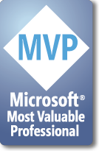




Azure
Obscured by Clouds
einar@dolittle.com
twitter.com/einari
http://www.ingebrigtsen.info

Slide 3



What is the cloud?
An approach to computing that’s about internet scale and connecting to a variety of devices and endpoints
Notes:
Slide Objectives:
Explain how Microsoft thinks of the cloud
Speaking Points:
There are numerous terms and definitions floating around in the industry for “the cloud”, “cloud computing”, “cloud services”, etc.
Microsoft thinks of the cloud as simply an approach to computing that enables applications to be delivered at scale for a variety of workloads and client devices.
The cloud can help deliver IT as a standardized service…freeing you up to focus on your business

Slide 4
Capacity challenges
Allocated IT-capacities
Load Forecast
Not Enough Power
=
Grumpy Customers & Unhappy CEO
Too Much Power = Unhappy CFO
IT CAPACITY
Actual Load
TIME
Notes:
Slide Objectives:
Understand the challenges of irregular load in applications
Understand the challenges of both too much capacity and not enough capacity and the sort of groups they impact within a customer
Understand that traditionally IT capacity is purchased in a stepwise fashion involving capital expenditure at each point
Speaking Points:
To understand the value and opportunity for cloud computing, I believe it’s important to think about how IT capacity is typically used by applications today in most environments.
Today most organizations significantly over estimate or underestimate the amount of resources they need to run their applications.
This leads to a higher cost for the infrastructure and the delivery of the overall applications.
Build Steps:
Forecast load is to grow steadily
Planned capacity grows in a stepwise fashion. Need to plan in advance due to hardware lead times
Actual load is highly variable over time
Periods where we have excess capacity. Capital laying idle, opex wasted powering and cooling servers
Periods where we have insufficient capacity and our customers get a bad experience

Slide 5
Capacity tuning
Load Forecast
No screaming customers
=
Quiet CEO Golf Days
Capacity on Demand
IT CAPACITY
No capital laying idle
= Happy CFO
Knob goes up...
And...
down
Lower Capex
Actual Load
Time
Notes:
Slide Objectives:
Understand that Windows Azure allows capacity to be turned on and off easily
Capacity can be brought on stream very quickly (no need to order servers in advance)
Speaking Points:
Lowers capex through not having to pay for hardware
Reduces waste of ovefr capacity
Ensures we can always provision enough capacity for peak periods
Can reduce capacity if demand subsides

Slide 6

Cloud Workflow Patterns
“On and Off “
“Growing Fast“
Inactivity
Period
Compute
Compute
Average
Usage
Average Usage
Time
Time
On & off workloads (e.g. batch job)
Over provisioned capacity is wasted
Time to market can be cumbersome
Successful services needs to grow/scale
Keeping up w/ growth is big IT challenge
Cannot provision hardware fast enough
“Unpredictable Bursting“
“Predictable Bursting“
Compute
Compute
Average Usage
Average Usage
Time
Time
Unexpected/unplanned peak in demand
Sudden spike impacts performance
Can’t over provision for extreme cases
Services with micro seasonality trends
Peaks due to periodic increased demand
IT complexity and wasted capacity
Notes:
Slide Objective
Understand common cloud utilization patterns
Speaking Points:
On/Off
Application only runs at certain times
E.g. batch processing, running simulation jobs etc…
Growing fast
Business growing too fast to be able to use regular hosting approach- cannot procure and provision hardware fast enough
E.g. Startup that goes Viral
Unpredictable Bursting
Sudden news event massively increases demand on application
Ability to scale may be difference between staying up (and making lots of money) and failing due to too much demand
E.g. Pop Start fan site when the pop star dies
Predictable Bursting
Well know periods of peak demands
e.g. Tickets going on sale for a big rock concert

Slide 7



Cloud Services
“IaaS”
“PaaS”
“SaaS”
Infrastructure-as-a-Service
Platform-as-a-Service
Software-as-a-Service
host
build
consume
Notes:
Slide Objectives:
Explain the three established terms in the industry for cloud services
Speaking Points:
With this in mind, it’s important to understand how to talk about our Cloud Services offerings.
There is a lot of confusion in the industry when it comes to the cloud.
It’s important that you understand both what is happening in the industry and how we think about the cloud.
This is the most commonly used taxonomy for differentiating between types of cloud services.
The industry has defined three categories of services:
IaaS – a set of infrastructure level capabilities such as an operating system, network connectivity, etc. that are delivered as pay for use services and can be used to host applications.
PaaS – higher level sets of functionality that are delivered as consumable services for developers who are building applications. PaaS is about abstracting developers from the underlying infrastructure to enable applications to quickly be composed.
SaaS – applications that are delivered using a service delivery model where organizations can simply consume and use the application. Typically an organization would pay for the use of the application or the application could be monetized through ad revenue.
It is important to note that these 3 types of services may exist independently of one another or combined with one another.
SaaS offerings needn’t be developed upon PaaS offerings although solutions built on PaaS offerings are often delivered as SaaS.
PaaS offerings also needn’t expose IaaS and there’s more to PaaS than just running platforms on IaaS.

Slide 8
Cloud Services
Packaged Software
Infrastructure
(as a Service)
Platform
(as a Service)
Software
(as a Service)
Applications
Applications
You manage
Applications
Applications
Data
You manage
Data
Data
Data
Runtime
Runtime
Runtime
Runtime
Managed by vendor
You manage
Middleware
Middleware
Middleware
Middleware
Managed by vendor
O/S
O/S
O/S
O/S
Virtualization
Virtualization
Managed by vendor
Virtualization
Virtualization
Servers
Servers
Servers
Servers
Storage
Storage
Storage
Storage
Networking
Networking
Networking
Networking
Notes:
Slide Objectives:
Explain the differences and relationship between IaaS, PaaS, and SaaS in more detail.
Speaking Points:
Here’s another way to look at the cloud services taxonomy and how this taxonomy maps to the components in an IT infrastructure.
Packaged Software
With packaged software a customer would be responsible for managing the entire stack – ranging from the network connectivity to the applications.
IaaS
With Infrastructure as a Service, the lower levels of the stack are managed by a vendor. Some of these components can be provided by traditional hosters – in fact most of them have moved to having a virtualized offering.
Very few actually provide an OS
The customer is still responsible for managing the OS through the Applications.
For the developer, an obvious benefit with IaaS is that it frees the developer from many concerns when provisioning physical or virtual machines.
This was one of the earliest and primary use cases for Amazon Web Services Elastic Cloud Compute (EC2).
Developers were able to readily provision virtual machines (AMIs) on EC2, develop and test solutions and, often, run the results ‘in production’.
The only requirement was a credit card to pay for the services.
PaaS
With Platform as a Service, everything from the network connectivity through the runtime is provided and managed by the platform vendor.
The Windows Azure Platform best fits in this category today.
In fact because we don’t provide access to the underlying virtualization or operating system today, we’re often referred to as not providing IaaS.
PaaS offerings further reduce the developer burden by additionally supporting the platform runtime and related application services.
With PaaS, the developer can, almost immediately, begin creating the business logic for an application.
Potentially, the increases in productivity are considerable and, because the hardware and operational aspects of the cloud platform are also managed by the cloud platform provider, applications can quickly be taken from an idea to reality very quickly.
SaaS
Finally, with SaaS, a vendor provides the application and abstracts you from all of the underlying components.

Slide 9
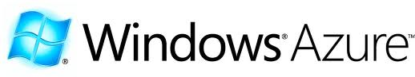







Cloud Offerings
Full Platform Stack
Limited Stack

Slide 10
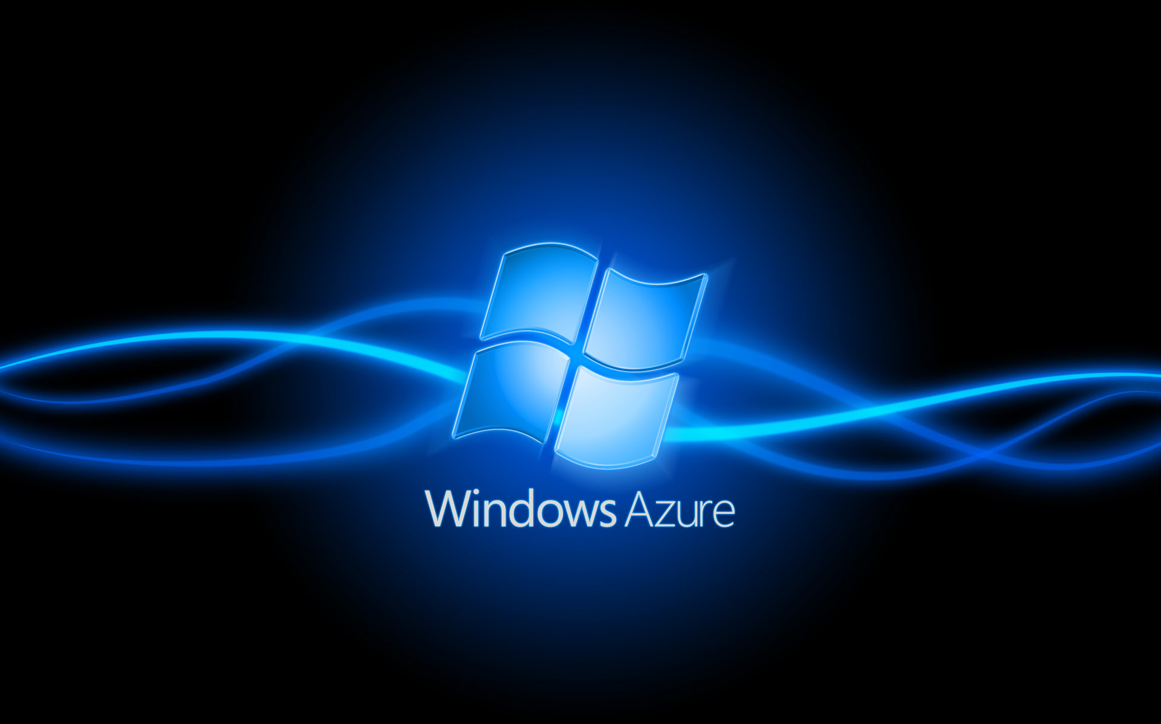

Slide 11
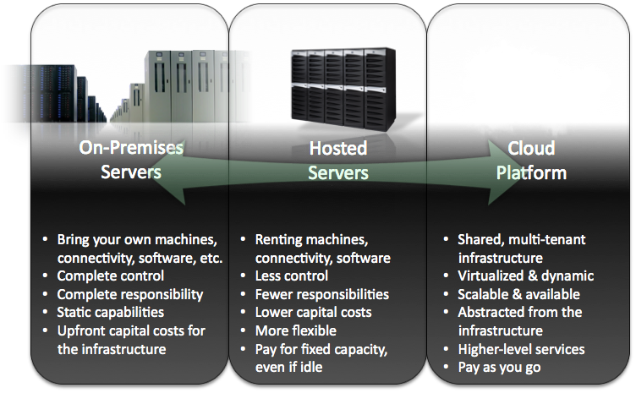
What is Windows Azure
Notes:
Slide objectives:
Explain what the cloud is in relationship to on-premises servers and hosted severs.
Speaking Points:
To put the cloud in perspective, let’s first think about the available options for deploying and running your application today.
Today, there are a few established approaches for deploying and running applications.
Server
On one side you have on-premises servers or a self-hosted model.
With on-premises servers, you bring your own machines, connectivity, software, and in some cases software licenses.
You have complete control of the environment, the software stack, the hardware, etc.
However, you also have complete responsibility. Your organization must have the skills and expertise to operate and manage the environment and software. You must take on the responsibility of patching the environment, replacing hardware, etc.
These days, very few people want to be in this business.
However, on-premises servers are not going away anytime soon.
In some cases organizations have to maintain solutions running in an on-premises environment due to regulatory, data, or privacy requirements.
Hosted Servers
An established alternative to the on-premises model is with a hosted environment.
With hosted servers, you are effectively renting capacity – including machines, connectivity, and in some cases software.
With this model, you have less control then when you’re managing your own servers. For instance, you can’t walk up to a machine, and plug in an external drive to load data. Or easily make hardware or software adjustments to optimize for performance.
However, you also have fewer responsibilities when it comes to operating, updating, patching, and managing the environment.
What is generally much more attractive about a hosted model is the cost model.
The upfront capital costs can be much lower then building out your own infrastructure.
However, one of the downsides is that you generally pay for the fixed capacity on a monthly basis – even if your application is idle.
Cloud
What we are starting to see in the industry is the emergency of the cloud as a platform for building and running applications.
So what is the cloud and how does it relate to these established options for running your apps?
A cloud platform is designed as a shared, multi-tenant infrastructure.
Cloud platforms utilize virtualization to: share hardware resources, provide isolation of applications or tenants, and also to provide a more dynamic infrastructure.
Ability to scale out your application over multiple server instances.
Because it is a shared infrastructure, there is even less control compared to a hosted environment.
As this is an emerging space, there is a wide range of different types of cloud solutions. Some of the solutions focus purely on providing virtualized infrastructure. Servers you can remote into.
However, many cloud platforms are starting to focus on raising the level of abstraction – so you can focus on building and deploying applications rather than remoting into machines and maintaining or patching servers.
Old:
Level of abstraction varies greatly today with the solutions in the market
Within the cloud, there are things that are delivered as an infrastructure
Services – services provided by the infrastructure and services you would consume programmatically
Finally, one of the primary reasons why organizations ranging from startups, independent software vendors, and large enterprises are starting to investigate the cloud is the pricing model.
With a cloud platform, you can expect a pay as you go pricing model – where you pay for what you use.
[build arrow]
I believe it’s important to understand that the cloud is part of a continuum. It is one of potential approaches that you can begin to use to deploy and run your applications. However, it’s important to understand that the cloud is not the silver bullet. It is not the perfect solution for every application.
Notes:
We view cloud as scale out, automated service management, high availability and multi-tenant
But cloud has other considerations: location, infrastructure, business model, ownership and management

Slide 12
What is Windows Azure
Operating system for the cloud
Hardware Abstraction across multiple servers
Distributed Scalable, Available Storage
Deployment, Monitoring and Maintenance
Automated Service Management, Load Balancers, DNS
Programming Environments
Interoperability
Designed for Utility Computing
Notes:
Key points here are to start to message that Windows Azure is designed for the cloud.
Scalability and Availability are the key design points here – remind people throughout the talk that its designed to be scalable and available.
Last point is important. Windows Azure only runs in Microsoft data centers. It’s not a shrink wrapped version of windows that they can buy and run in data centers themselves. There are no plans to do this.
You can draw the comparison between the desktop/server OS and the cloud OS. The desktop abstracts away things like printers, display drivers, memory etc. So you only have to worry about building your desktop application. The Cloud OS does this for the cloud, but instead of printers, display drivers etc. it does it across multiple servers, networking compoents, provides a “cloud file system” for storage, a programming environment etc.
The last 2 points:
1. Interoperability – the storage etc uses REST based protocols. Additionally, we support things like PHP, MySQL, Apache, etc. with the release of inter-role communication.
2. Designed for Utility Computing – Rather than charging a per-seat license etc. you will be charged by consumption. The pricing is available on the windowsazure.com website.

Slide 13
What is Windows Azure
Reduce complexity of scalability...
OS Takes care of your service in the cloud
Deployment
Availability
Patching
Hardware Configuration
You worry about writing the service
Notes:
Windows Azure is not about letting you setup and run an entire OS with your application.
Instead it is about running your service, using commodity servers that are managed by Microsoft. Microsoft take care of deploying your service, patching the OS, keeping your service running, configuring hardware, infrastructure etc. All of this is automated.
All you need to worry about is writing the service.

Slide 14
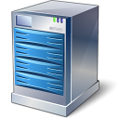


What is Windows Azure
Designed for scalability and availability

Slide 15





What is Windows Azure
Hosted by Microsoft
North America Region
Europe Region
Asia Pacific Region
N. Europe
W. Europe
N. Central – U.S.
S. Central – U.S.
E. Asia
S.E. Asia
6 datacenters across 3 continents
Notes:
Slide Objective
Understand that Microsoft has a long history in running data centres and online applications. Bing, Live, Hotmail etc….
Understand the huge amount of innovation going on at the data center level
Speaking Points:
Microsoft is one of the largest operators of datacenters in the world
Years of Experience
Large scale trustworthy environments
Driving for cost and environmental efficiently
Windows Azure runs in 3 regions and 6 datacenters today
Data center innovation is driving improved reliability and efficiency
PUE = Power Usage Effectiveness = Total Facility power/IT Systems Power = Indication of efficiency of DC
Under 1.8 is very good, modern cloud DCs approaching 1.2
Multi-billion dollar datacenter investment
700,000+ square foot Chicago and the 300,000+ square foot Dublin, Ireland data centers
Microsoft cloud services provide the reliability and security you expect for your business: 99.9% uptime SLA, 24/7 support.
Microsoft understands the needs of businesses with respect to security, data privacy, compliance and risk management, and identity and access control. Microsoft datacenters are ISO 27001:2005 accredited, with SAS 70 Type I and Type II attestations.
Notes:
http://www.globalfoundationservices.com/
http://blogs.msdn.com/the_power_of_software/archive/2008/06/20/microsoft-s-pue-experience-years-of-experience-reams-of-data.aspx
http://blogs.msdn.com/the_power_of_software/archive/2008/06/27/part-2-why-is-energy-efficiency-important.aspx

Slide 16
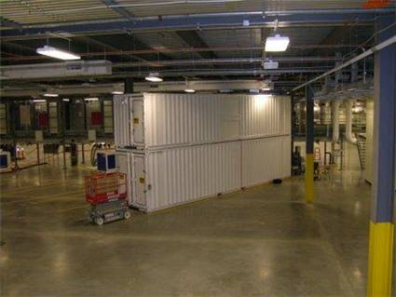
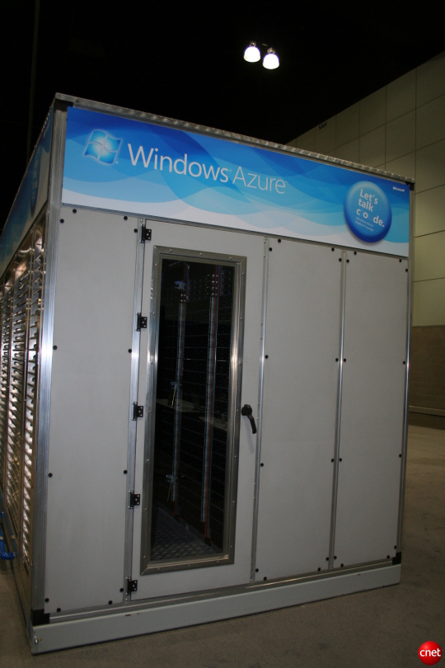
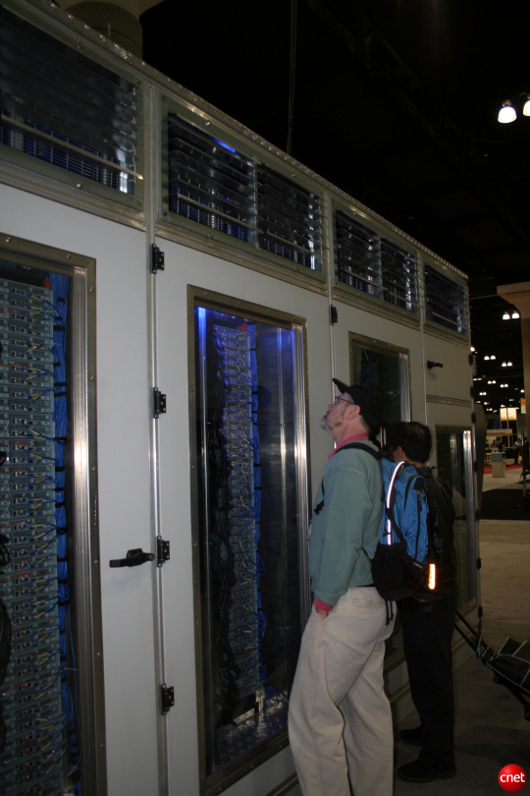
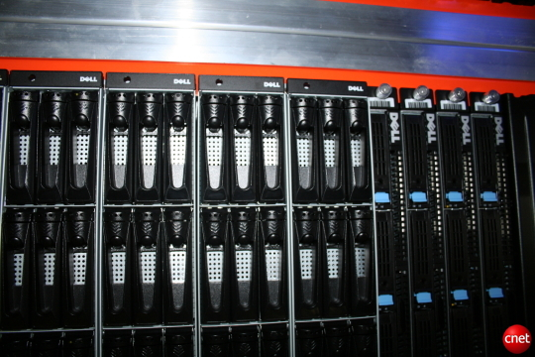
http://www.youtube.com/watch?v=8E8Wy3An3jA

Slide 17
What is Windows Azure
Features
Automated Service Management
Compute
Storage
Developer Experience
Notes:
Here are some of the features we’ll walk through in the next few minutes.

Slide 18
What is Windows Azure
Automated Service Management
Deploy at virtual endpoint – scaled out by Azure
Failover – one instance goes down, another one goes up
Scalability handled by Azure
Notes:
Here are some of the features we’ll walk through in the next few minutes.

Slide 19
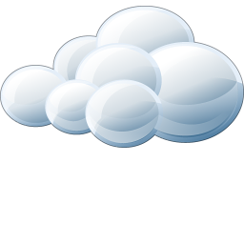
What is Windows Azure
Compute
Storage
AppFabric
Developer
SDK
Notes:
For you as a developer, there are 3 concepts you can be working with.
Compute – this is were you have your applications.
Storage – this is were you store your data
AppFabric – this is were you plugin existing infrastructure – Active Directory, ESB, etc...

Slide 20
What is Windows Azure
Compute
Web Role
Worker Role
Windows Server 2008 x64
IIS 7
ASP.net 4
FastCGI (PHP, Ruby++)
Native Code
Full Trust
User Mode
Windows Server 2008 x64
.net
Native Code
Full Trust
User Mode
Inbound any TCP port

Slide 21
What is Windows Azure
Storage
Durable, scalable, available
SQL Azure
Blobs
Drives
Tables
Queues
REST based
Notes:
This should give a short introduction to storage. Key points are its durable (meaning once you write something we write it to disk), scalable (you have multiple servers with your data), available (the same as compute, we make sure the storage service is always running – there are 3 instances of your data at all times).
Quickly work through the different types of storage:
Blobs – similar to the file system, use it to store content that changes, uploads, unstructured data, images, movies etc.
Drives – an NTFS mountable drive backed over blob storage. This enables interop and traditional file system capabilities over blob storage backing
Tables – Semi-structured, provides a partitioned entity store (more on partitions etc. in the Building Azure Services Talk) – allows you to have tables containing billions of rows, partitioned across multiple servers.
Queues – Simple queue for decoupling Computer Web and Worker Roles.
All access is through REST interface. You can actually access the storage from outside of the data center (you don’t need compute) and you can access storage via anything that can make a HTTP request.
It also means table storage can be accesses via ADO.NET Data Services.

Slide 22
What is Windows Azure
Virtual Machine Role
Host your own server in the cloud
Must be a Win2008 R2 x64
Stateless

Slide 23
What is Windows Azure
Hardware
Hardware Load Balancers
Servers
Networks
DNS
Monitoring
Automated service management
Notes:
Remind them the cloud is all the hardware across the board.
Point out the automated service management,

Slide 24

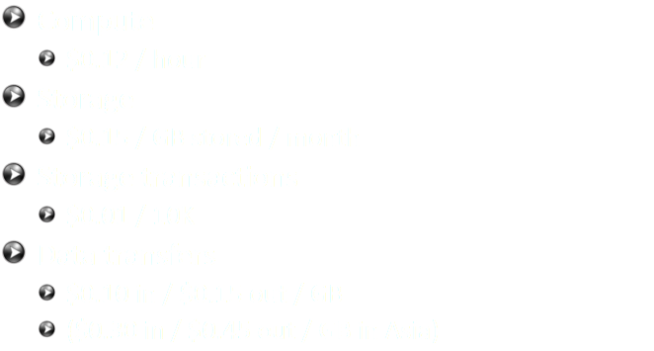
Pricing
Notes:
I tillegg kommer det en månedspris per database basert på størrelsen
Enterprise har tilleggs priser dersom man trenger større databaser (10,20,30,40 eller 50 GB)

Slide 25
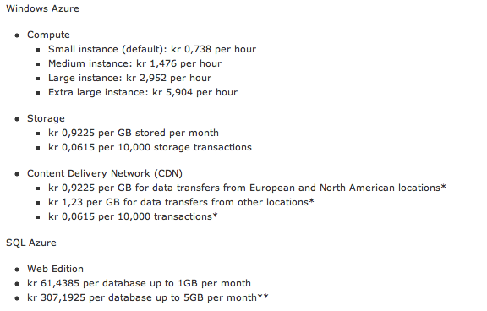

Pricing
http://www.microsoft.com/windowsazure/pricing-calculator/

Slide 26
Instance Sizes & Prices
X-Small
Small
Medium
Large
X-Large
$0.05
$0.12
$0.24
$0.48
$0.96
Per service hour
Per service hour
Per service hour
Per service hour
Per service hour
X-Small
Small
Medium
Large
X-Large
1 x 1.0Ghz
1 x 1.6Ghz
2 x 1.6Ghz
4 x 1.6Ghz
8 x 1.6Ghz
(low IO)
(moderate IO)
(high IO)
(high IO)
(high IO)
768 MB memory
1.75 GB memory
3.5 GB memory
7.0 GB memory
14 GB memory
20 GB storage
(instance storage)
250 GB storage
(instance storage)
500 GB storage
(instance storage)
1000 GB storage
(instance storage)
2000 GB
(instance storage)
Notes:
Slide Objectives:
Explain that there are different VM instance sizes available within Windows Azure
Speaking Points:

Slide 27

Service Level Agreement
Compute
connectivity
Instance monitoring and restart
Storage
availability
Database
availability
Service bus and access control availability
Your service is connected and reachable via web. Internet facing roles will have external connectivity
All running roles will be continuously monitored
If role is not running, we will detect and initiate corrective state
Storage service will be available/reachable (connectivity)
Your storage requests will be processed successfully
Database is connected to the internet gateway
All databases will be continuously monitored
Service bus and access control endpoints will have external connectivity
Message operation requests processed successfully
>99.95%
>99.9%
>99.9%
>99.9%
>99.9%
Notes:
Slide Objectives:
Explain the SLAs for the Windows Azure Platform
Speaking Points:

Slide 28

Legal
You own the data (of course)
Region-based
Notes:
In most cases, you must take into account the laws of the country the datacenter you deploy to is in

Slide 29

The tools
Visual Studio 2008
Visual Studio 2010
Azure SDK

Slide 30

More tools
SQL Azure Migration Wizard
SQL Server to SQL Azure
SQL Azure to SQL Server
SQL Azure to SQL Azure
http://sqlazuremw.codeplex.com/

Slide 31
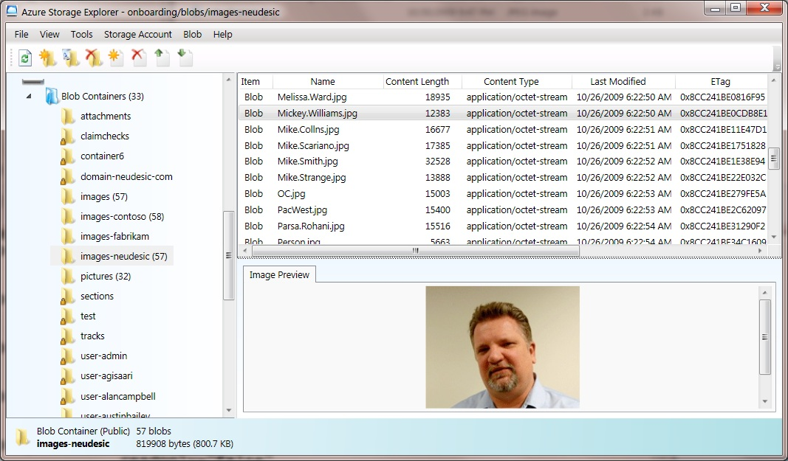
More tools
Azure Storage Explorer
http://azurestorageexplorer.codeplex.com/

Slide 32
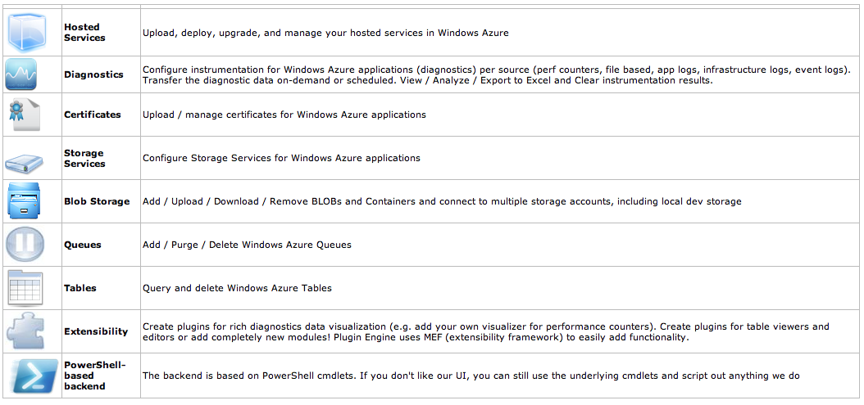
More tools
Azure Management Tool (MMC)
http://code.msdn.microsoft.com/windowsazuremmc

Slide 33

The fabric

Slide 34
The operating system
Windows 2008 kernel based
Cloud OS – latest version 1.8

Slide 35

Affinity groups
Geograpical grouping
Keep your data close

Slide 36


Slide 37
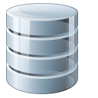
SQL

Slide 38
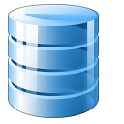

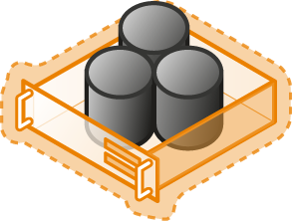


SQL Azure
Database choices
Value Props:
Full h/w control – size/scale
100% compatibility
Roll-your-own HA/DR/scale
Value Props:
100% of API surface area
Roll-your-own HA/DR/scale
On-premise
Value Props:
Auto HA, Fault-Tolerance
Friction-free scale
Self-provisioning
High compatibility
SQL Server or other s/w on-premise
Resource governance @ machine
Security @ DB Server/OS
Resources
Hosted
Hosted SQL Server or other
Resource governance @ VM
Security @ DB Server/OS
SQL Azure (RDBMS)
Virtual DB server
Resource governance @ LDB
Security @ LDB
Low
“Friction”/Control
High

Slide 39




SQL Azure
Self-managed
Elastic Scale
Developer Agility
Easy provisioning and deployment
Auto high-availability and fault tolerance
Self-maintaining infrastructure; self-healing
No need for server or VM administration
Database utility; pay as you grow
Flexible load balancing
Business-ready SLAs
Enable multi-tenant solutions
World-wide presence
Build cloud-based database solutions on consistent relational model
Leverage existing skills through existing ecosystem of developer and management tools
Explore new data application patterns
Notes:
The first and only true relational database as a service

Slide 40
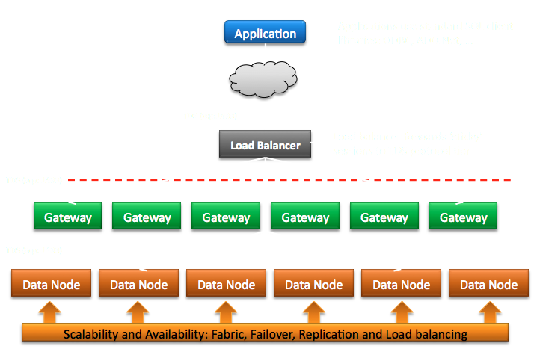
SQL Azure
Network topology

Slide 41
SQL Azure
Architecture
Shared infrastructure at SQL database and below
Request routing, security and isolation
Scalable HA technology provides the glue
Automatic replication and failover
Provisioning, metering and billing infrastructure
SDS Provisioning (databases, accounts, roles, …, Metering, and Billing
Machine 4
Machine 5
Machine 6
SQL Instance
SQL Instance
SQL Instance
SQL DB
SQL DB
SQL DB
User DB1
User DB2
User DB3
User DB4
User DB1
User DB2
User DB3
User DB4
User DB1
User DB2
User DB3
User DB4
Scalability and Availability: Fabric, Failover, Replication, and Load balancing
Scalability and Availability: Fabric, Failover, Replication, and Load balancing

Slide 42
SQL Azure
Database Replicas

Slide 43
SQL Azure
Database Editions
Two SQL Azure Database SKUs: Web & Business
Web Edition: 1 GB @ $9.99/month | 5 GB @ $49.95/month
Business Edition: Up to 50 GB @ $99.99/10 GB/month 10 GB @ $99.99 | 20 GB @ $199.98 | 30 GB @ $299.97 | 40 GB @ $399.96 | 50 GB @ $499.95
You specify Web or Business Edition
Web: EDITION = Web
Business: EDITION = Business
You specify MAXSIZE
Web: MAXSIZE = 1GB| 5GB
Business: MAXSIZE = 10GB | 20GB | 30GB | 40GB | 50GB
This is the size we will not let you grow beyond
You will be charged for the actual (peak) size (in any one day)
CREATE DATABASE foo1 (EDITION='business', MAXSIZE=50GB);
CREATE DATABASE foo2 (EDITION='business', MAXSIZE=30GB);
CREATE DATABASE bar1 (EDITION='web', MAXSIZE=5GB);
CREATE DATABASE bar2 (EDITION='web'); -- Defaults to 1GB
Business Edition
Up to 50 GB
10 GB increments
Web Edition
Up to 5 GB
1 or 5 GB

Slide 44
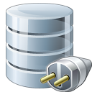
Connecting
ADO.net, ODBC
OleDb is not supported
May need <login>@<server>
USE statement is NOT supported

Slide 45
Toolset
SQLCmd
OSQL
SQL Server 2008 R2 Management Studio
Project “Houston”
etc..

Slide 46

Security
Supports SQL Server Security
On-premise SQL security concepts still apply
Server-level : sds_dbcreator, sds_securityadmin roles
Database level: same as on-premise
Administrative user is equivalent to sa

Slide 47
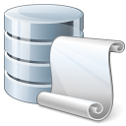
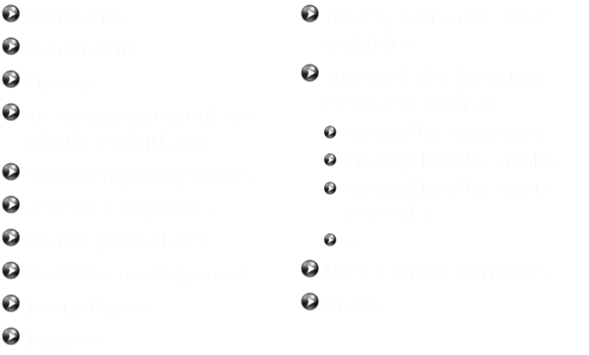
T-SQL

Slide 48
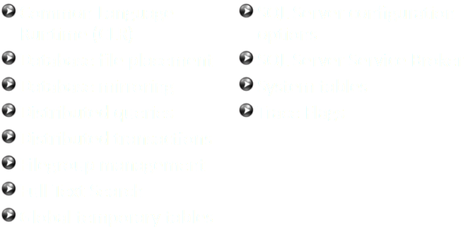
T-SQL (unsupported)

Slide 49
Throttling
Use traditional SQL Server best practices
CTP cluster has throttling limits turned up to allow for building logic into apps for handling this case
Build in retry logic especially if you expect very high throughput demands
Consider scaling out for high throughput scenarios
Notes:
Excessive resource usage
Execute transaction in the while loop
Catch throttling errors that result in connection closed
Pause for a few seconds and reconnect
Continue to execute transactions in the loop

Slide 50
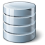
Scaling out
Scale out when…
…you need more throughput
…data is exceeding capacity of server
Instead of one big database (10GB), logical partioning into smaller 1GB will scale better

Slide 51
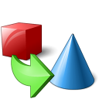
Using an ORM
Fully SQL on-premise compatibility
Entity Framework
Linq2Sql
NHibernate

Slide 52
Backup?
Currently no backup support – its coming!
Make notice of force majeure in SLA
Use copies – TSQL “as COPY OF”
http://mooneyblog.mmdbsolutions.com/index.php/2011/01/11/simple-database-backups-with-sql-azure

Slide 53
SQL Azure Data Sync
Currently in CPT
Sync on-premise with SQL Azure
Sync Azure to Azure

Slide 54
Business Intelligence
Business Intelligence Design Studio
Report Builder – deploy through BIDS
Security : SQL Azure username/password

Slide 55
Project Crescent
Part of “Denali” – next SQL release
Silverlight based
Realtime interactive reporting
http://blogs.msdn.com/b/bi/archive/2010/11/09/data-visualization-done-right-project-crescent.aspx

Slide 57
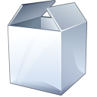
Storage

Slide 58
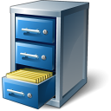
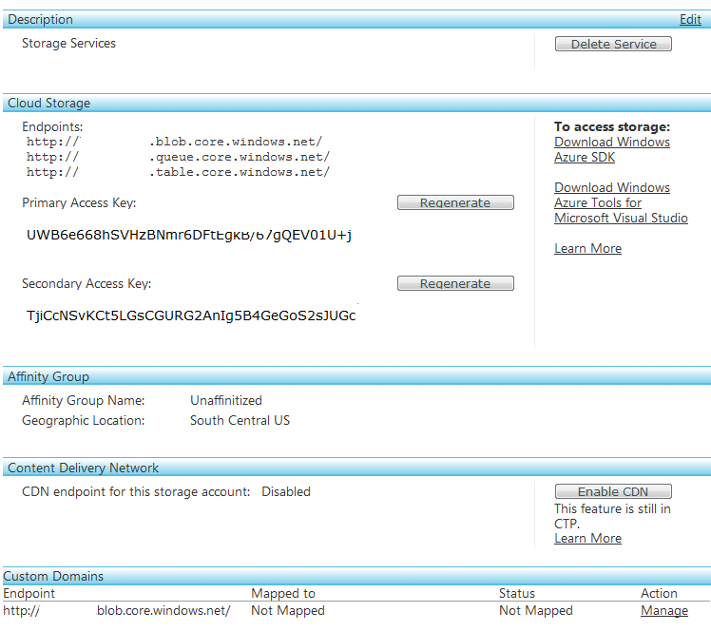
Storage
Create a Storage Account
Endpoints
Access Keys
CDN
Notes:
Storage in the cloud requires you to create a storage account.
Once you have created a storage account, you can then use it from code running anywhere. Local Dev Fabric, Cloud or anywhere else.
The web portal shows the endpoints available as well as the shared keys.
Note for the local developer storage, the shared key is the same, and is contained in the sample storage client project.

Slide 59
Storage
100 TB per account
Blobs, Drives, Tables, Queues
Designed for the cloud
3 replicas
Guaranteed consistency
Accessible directly from the internet via REST API
.NET Client library supported
Does not require compute
Storage account drives unique URL, e.g.:
https://<youraccount>.blob.core.windows.net
Notes:
In this next section, we’ll dig a little deeper on storage.
Recall there are 3 types of storage.
Recall the design point is for the cloud, there are 3 replicas of data, and we implement guaranteed consistency. In the future there will be some transaction support and this is why we use guaranteed consistency.
Access is via a storage account – you can have multiple storage accounts per project.
Although the API is REST, there is a supported .net storage client in the SDK that you can use within your project. This makes working with storage much easier.

Slide 60
Storage Account
User creates a globally unique storage account name
Can choose geo-location to host storage account
“US Anywhere”, “US North Central”, “US South Central”,
Can co-locate storage account with compute account
Receive a 256 bit secret key when creating account
Storage Account Capacity at Commercial Availability
Each storage account can store up to 100 TB
Default limit of 5 storage accounts per subscription

Slide 61

Blob Storage
Partitioned by container
Unlimited containers
Large objects (100s of GBs in size)
VHD files
CDN Capable
Accessible from REST interface
Notes:
2 types of Blob types :
Block Blob – streaming
Page blob – random read/write workloads
Blobs
Blobs are stored in containers. There are 0 or more blobs per container and 0 or more containers per account. (since you can have 0 containers, but then you would not have any blobs either)
Typically url in the cloud is http://accountname.blob.core.windows.net/container/blobpath
Blob paths can contain the / character, so you can give the illusion of multiple folders, but there is only 1 level of containers.
Blob capacity at CTP is 50gb.
There is an 8k dictionary that can be associated with blobs for metadata.
Blobs can be private or public:
Private requires a key to read and write
Public requires a key to write, but NO KEY to read.
Use blobs where you would use the file system in the past.

Slide 62
Blob Concepts
Account
Container
Blob
Blocks or Pages
IMG001.JPG
Pictures
IMG002.JPG
Account
Block/Page 1
Movies
MOV1.AVI
Block/Page 2
Block /Page 3
Notes:
This diagram illustrates the link between accounts, containers and blobs – but also introduces the concept of blocks.
Problem: If you want to load large blobs into storage, you don’t want to have to upload the entire blob in one go. This would be painful to do if you had to handle network failures etc. so instead, you can upload the blob as a series of blocks.

Slide 63
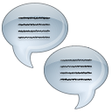
Queues
Simple async dispatch queue
Read at least once
Max size : 8kb
Delete to remove message, otherwise is returned to queue
Partitioned by Queue Name
Operations : put, get, delete
Can resemble mailslot or named pipes
Notes:
Queues in Windows Azure are fairly simple.
You can pop messages in, and read messages out.
Messages are stored on the same system as blobs and tables, so once you write a message you can be sure it is durable.
There are no transactions, instead.
When you read a message, it is hidden from the queue.
Once you have finished processing the message, you should delete the message from the queue. This removes it.
If you do not delete the message, after a user configurable amount of time, the message is made visible in the queue again. (there is no guarantee of ordering)
Queues are simple:
Messages are placed in queues. Max size is 8k (and it’s a string)
Message can be read from the queue, at which point it is hidden.
Once whatever read the message from the queue is finished processing the message, it should then remove the message from the queue. If not the message is returned to the queue after a specific user defined time limit. This can be used to handle code failures etc.

Slide 64
Queue concepts
Account
Queue
Message
128x128, http://…
Thumbnail Jobs
256x256, http://…
Account
http://…
Indexing Jobs
http://…
Notes:
Queues in Windows Azure are fairly simple.
You can pop messages in, and read messages out.
Messages are stored on the same system as blobs and tables, so once you write a message you can be sure it is durable.
There are no transactions, instead.
When you read a message, it is hidden from the queue.
Once you have finished processing the message, you should delete the message from the queue. This removes it.
If you do not delete the message, after a user configurable amount of time, the message is made visible in the queue again. (there is no guarantee of ordering)

Slide 65
Queues
Decoupling
Web Role
Worker Role
Web Role
Worker Role
Worker Role
Worker Role
Storage
LB
LB
Queue
Notes:
When building services, sometimes you want to handle user requests quickly, but process the actual work in the background.
Other times you have tasks that need to be performed at certain times, or you need to maintain some database de-normalization.
This is where a worker role can help. But how does a worker role know when and what to do its work with.
This is where a Queue comes in useful.
Queues are simple, durable first-in-last-out constructs that are persisted to storage. (meaning when you write a message to a queue, its written to disk, and replicated 3 times)
The typical pattern is that a request comes in from the web-role, which places a message in the queue. The worker role, at some point in the future, simply reads the message and performs some unit of work.
There is no transaction support in Queues. Instead, when you read a message its hidden from the queue. If you complete the work, you can then call a deleteMessage method which will permanently delete the message from the queue. If you do not call deleteMessage, the message will be placed back on the queue after a user-configurable amount of time (default 30 seconds).
There are number of reasons why you may not call deleteMessage, including:
Your code fails
There is a hardware failure, effectively killing your worker role code
There worker role is instructed to stop, and you have no code implemented to do that in a timely fashion.
For this reason, you should design the tasks your worker role does to be Idempotent – which basically means that you should be able to do the same task twice, without it having an adverse effect on the system state.
e.g. – If the worker is sent the name of a picutre stored in blob storage that it would resize, it does not matter how many times it resizes the image, the outcome is the same. This is idempotent.
If a worker is incrementing a balance, it DOES matter how many times this occurs – this is NOT idempotent.

Slide 66

Table storage
Entity Data Store
Partitioned by key
Unlimited keys
Not a RDBMS
Notes:
Tables are NOT Relational databases.
They are a collection of entities.
Key design points are scale for millions+ rows across multiple storage servers (which is transparent to the user)
Data is scaled out using partitions. As the developer, you can choose how the data is partitioned based upon usage.
Tables are simply collections of Entities.
Entites must have a PartitionKey and RowKey – can also contain up to 256 other properties.
Entities within a table need not be the same shape! E.g.:
Entity 1: PartitionKey, RowKey, firstname
Entity 2: PartitionKey, RowKey, firstname, lastname
Entity 3: PartitionKey, Rowkey, orderId, orderData, zipCode
Partitions are used to spread data across multiple servers. This happens automatically based on the partition key you provide. Table “heat” is also monitored and data may be moved to different storage endpoints based upon usage.
Queries should be targeted at a partition, since there are no indexes to speed up performance. Indexes may be added at a later date.
Its important to convey that whilst you could copy tables in from a local data source (e.g. sql) it would not perform well in the cloud, data access needs to be re-thought at this level. Those wanting a more traditional SQL like experience should investigate SDS.

Slide 67
Table storage concepts
Account
Table
Entity
Name=…hash=…
Users
Name=…hash=…
Account
Tag=…id=…
PhotoIndex
Tag=…,id=…
Notes:
Tables are NOT Relational databases.
They are a collection of entities.
Key design points are scale for millions+ rows across multiple storage servers (which is transparent to the user)
Data is scaled out using partitions. As the developer, you can choose how the data is partitioned based upon usage.
Some key things to remember
Design points are scalability and availability – think it terms of lots of small servers rather than a single BIG server.
Table storage is semi-structured – ITS NOT A RELATIONAL DATABASE – IT NEVER WILL BE. THAT IS SDS.
Everything is stateless (you can maintain state in table or blob storage if YOU want to)
Decouple everything using queues, and write code to be repeatable without breaking anything – in other words design for failure!
Instrument and log your application yourself.
Work on the idea that once you are on – stay on.
How will you patch/update your service once it is switched on?

Slide 68
Entities and properties
Each Entity can have up to 255 properties
Every Entity has fixed key properties
Partition key
Row key
Timestamp
No fixed schema for rest of properties
2 entities in the same table can have different properties
Properties stored as <Name, TypedValue> pairs
Each entity has a system maintained version
Notes:
Key point is the PartitionKey and RowKey – these together should be unique.
Within a partition, rowkey must be unique.
Currently in the PDC CTP, there are only indexes on PartitionKey & RowKey, no other properties are indexed.
Since tables have no fixed schema, every single entity can be an entirely different shape, the only things that are required are the partition & Row keys.
The system maintained version is useful when handling concurrency (as will be shown later)

Slide 69
Entities and properties
Partition key and Row key
String (up to 1KB)
Other properties
String (up to 64KB)
Binary (up to 64KB)
Bool
DateTime
GUID
Int
Int64
Double
Notes:
Standard property types – Ask What is missing? – DECIMAL!
Although the RowKey property may have a value up to 1 KB in size, only a total of 256 characters can be specified for the partition key and row key together on the URL. If your combined key values exceed 256 characters, use a batch operation to retrieve the entity instead.

Slide 70
Partitioning
Every entity has a partition key
All entities in a table with the same partition key value live in the same partition
Important to choose partitioning scheme to make data access scalable
Notes:
Again, get home the message that tables are just collections of entities. For perf and scalability, you need to think about how the data should be partitioned.

Slide 71
Partitioning
Performance
Use a PartitionKey that is common in your queries
Always try to specify the partition key in the query
Entities with same partition key value are clustered
Batch capabilities and transaction are supported within a partition only.
Scalability
We monitor partition traffic
Automatically load balance partitions
Each partition can potentially be served by a different storage node
Scale to meet the traffic needs of your application
More partitions – makes it easier to balance load
Notes:
Again, get home the message that tables are just collections of entities. For perf and scalability, you need to think about how the data should be partitioned.

Slide 72

Content Delivery Network
Currently 24 nodes around the world
Scalability
Parallel download of content
You control were you want your content
There is a pricetag for transferring between locations

Slide 73
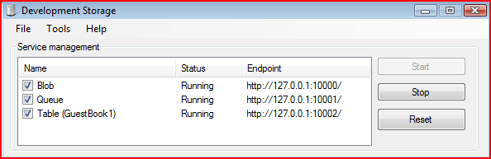
Storage Emulator
Provides a local “Mock” storage
Emulates storage in cloud
Allows offline development
Requires SQL Express 2005/2008
Notes:
The Dev Fabric (or cloud in a box) provides a local “Mock” implementation of the cloud. It’s a “Mock” because its not the actual cloud code, instead it’s a wrapper around SQL Express that exposes the same API as the cloud. This allows you to develop offline.
As you can see from the screenshot, the 3 services are exposed to 3 different endpoint addresses – all local.

Slide 75

Services

Slide 76

Service Architecture
LB
Windows Azure
LB
Queues
Storage
Web Site
(ASPX, WCF, etc.)
Worker Service
Tables
Blobs
Notes:
Key points here are that all external connections come through a load balancer. If you are familiar with the previous model, you will notice that two new features are diagrammed here as well, namely inter-role communication (notice there is no loadbalancer) and TCP ports directly to Worker Roles (or Web Roles). We will still use the storage to communicate async and realiably via queues for a lot of options. However, inter-role communication fills in when you need direct synchronous comm.

Slide 77
Roles
Inherits RoleEntryPoint
OnStart() Method
Called by Fabric on startup, allows you to perform initialization tasks.
Reports Busy status to load balancer until you return true.
OnStop() Method
Called when role is to be shutdown, graceful exit.
Run() Method
Main logic is here – can do anything, typically loop and never exit.
Notes:
Worker role is similar to a windows service. It gets started once deployed, and will get stopped when required.
It could get stopped because
we are re-deploying you to a different server
You actioned the stop from the web-portal
It’s up to you to keep running and NEVER return from Start() unless you have been told to stop. Note: you do not need to handle the stop – you can simply “fail”

Slide 78

Web Role
Notes:
Web Roles run ASP.NET websites, pretty much anything that will work in a standard IIS ASP.NET Web Site should work in Windows Azure. At MIX09, we additionally added support for IIS7’s FastCGI capability. This allows any FastCGI application (like PHP) to run in Windows Azure as well. This was made possible not only by adding the FastCGI support, but by adding Full Trust support that was necessary to launch native code like a FastCGI process.
Additionally, in order to support FastCGI, we had to add a new configuration file called “web.roleConfig” that houses those settings that would normally be in the applicationHost.config on an IIS7 server. The reason is that applicationHost.config also houses some system wide settings for things like Application Pools and security settings that can’t be changed for security, deployment and stability reasons. This separate config file allows us to isolate the system settings that can be changed inside Windows Azure.
As a note, any files that are part of a asp.net project on windows azure are READ ONLY! If you need to be able to change the contents of files:
User Blob Storage
If its configuration, use the service model files – which can be changed at runtime.
Inbound protocols are http(s) – outbound protocols are any TCP connection but NOT UDP.

Slide 79
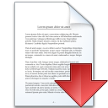
Content
Regular ASP.net based projects
.net 4 support
ASP.net 4
ASP.net MVC 1,2 and 3
Notes:
Web Roles run ASP.NET websites, pretty much anything that will work in a standard IIS ASP.NET Web Site should work in Windows Azure. At MIX09, we additionally added support for IIS7’s FastCGI capability. This allows any FastCGI application (like PHP) to run in Windows Azure as well. This was made possible not only by adding the FastCGI support, but by adding Full Trust support that was necessary to launch native code like a FastCGI process.
Additionally, in order to support FastCGI, we had to add a new configuration file called “web.roleConfig” that houses those settings that would normally be in the applicationHost.config on an IIS7 server. The reason is that applicationHost.config also houses some system wide settings for things like Application Pools and security settings that can’t be changed for security, deployment and stability reasons. This separate config file allows us to isolate the system settings that can be changed inside Windows Azure.
As a note, any files that are part of a asp.net project on windows azure are READ ONLY! If you need to be able to change the contents of files:
User Blob Storage – sticky to the instance
If its configuration, use the service model files – which can be changed at runtime.
Inbound protocols are http(s) – outbound protocols are any TCP connection but NOT UDP.

Slide 80

FastCGI
enableNativeCodeExecution in Service definition file
Web.roleconfig
Setup fastCgi pointing to the executable to run for requests
Web.config
Add HTTP handler for the executable/script processor
Put the CGI executable in your role (xcopy deployable)
http://blogs.msdn.com/b/windowsazure/archive/2009/03/18/using-3rd-party-programming-languages-via-fastcgi.aspx
http://msdn.microsoft.com/en-us/library/dd179406.aspx

Slide 81

Worker Role

Slide 82

“Windows Service”
Run() method is your main method
Runs full trust
Can listen to TCP incoming requests
Notes:
Worker role is similar to a windows service. It gets started once deployed, and will get stopped when required.
It could get stopped because
we are re-deploying you to a different server
You actioned the stop from the web-portal
It’s up to you to keep running and NEVER return from Start() unless you have been told to stop. Note: you do not need to handle the stop – you can simply “fail”

Slide 83

Configuration
Service Configuration
Serviceconfiguration.csdef – Service Model
ServiceConfiguration.cscfg – instance data
RoleEnvironment.GetConfigurationSettingValue()
Don’t use web.config for values you wish to change at runtime
Web.config change requires re-deploy
Notes:
Web.config is used today to store configuration for asp.net web sites. Most ASP.NET things still require this, e.g. tracing, security etc.
Web.config cannot be changed once deployed – it’s a static file.
Instead you should store configuration that will change in the ServiceConfiguration files, and use the RoleEnvironment.GetConfigurationSetting method to read the value. Settings in the ServiceConfiguration file can be changed at runtime without recompiling!

Slide 84

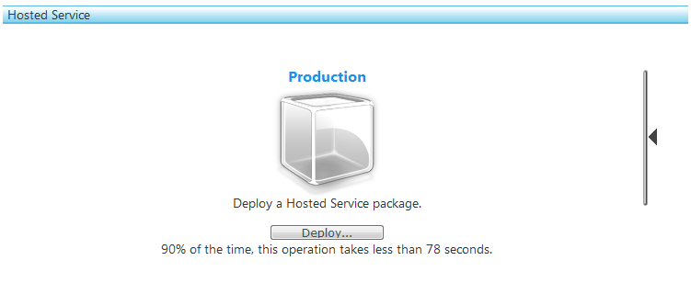
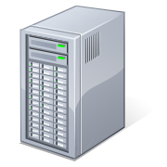
Deployment
ServicePackage
ServiceConfiguration

Slide 85
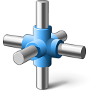
Decoupling
Use Queues to Decouple
Design for Idempotency
Multiple instances of same message/operation does not change the result
Ordering is important to deal with
Notes:
When building services, sometimes you want to handle user requests quickly, but process the actual work in the background.
Other times you have tasks that need to be performed at certain times, or you need to maintain some database de-normalization.
This is where a worker role can help. But how does a worker role know when and what to do its work with.
This is where a Queue comes in useful.
Queues are simple, durable first-in-last-out constructs that are persisted to storage. (meaning when you write a message to a queue, its written to disk, and replicated 3 times)
The typical pattern is that a request comes in from the web-role, which places a message in the queue. The worker role, at some point in the future, simply reads the message and performs some unit of work.
There is no transaction support in Queues. Instead, when you read a message its hidden from the queue. If you complete the work, you can then call a deleteMessage method which will permanently delete the message from the queue. If you do not call deleteMessage, the message will be placed back on the queue after a user-configurable amount of time (default 30 seconds).
There are number of reasons why you may not call deleteMessage, including:
Your code fails
There is a hardware failure, effectively killing your worker role code
There worker role is instructed to stop, and you have no code implemented to do that in a timely fashion.
For this reason, you should design the tasks your worker role does to be Idempotent – which basically means that you should be able to do the same task twice, without it having an adverse effect on the system state.
e.g. – If the worker is sent the name of a picutre stored in blob storage that it would resize, it does not matter how many times it resizes the image, the outcome is the same. This is idempotent.
If a worker is incrementing a balance, it DOES matter how many times this occurs – this is NOT idempotent.

Slide 86
Upgrading
Two Models: VIP Swap and In-Place Upgrade
VIP Swap:
Uses Staging and Production environments.
Allows to quickly swap environments.
Production: v1 ➔ Staging: v2, after swap then Production: v2 ⬅ Staging: v1.
In-Place Upgrade
Performs a rolling upgrade on live service.
Entire service or a single role
Manual or Automatic across update domains
Notes:
Currently the CTP allows for 2 deployment packages as part of the same project.
These are known as “Production” and “Staging”
Each package has a unique version for that project.
The “production” package services requests from the website URL. Worker roles operate normally.
Any package in “Staging” will only server web requests from a temp URL – which is a GUID and is shown below the package. This is great to run smoke tests on.
NOTE: worker roles in the “Staging” project are operational – and as such will process messages from queues etc. You should design for this.
To switch between “Production” and “Staging” you simply click the swap button in the middle. This simply changes where the load balances service requests from, there is no moving of packages from “staging” servers to “production” servers. They are all the same!
If you deployed a package to production earlier, you may want to show deploying to staging and swapping, however since it takes 5+ minutes to deploy, this may not be a quick demo and you may have to come back to it.

Slide 88

AppFabric

Slide 89

Access Control
Federate users from existing AD
Services can use for SSO
Service Bus can use for authentication

Slide 90

Caching
Distributed
In-memory
Cloud-service

Slide 91
Caching - pricing
Size | Monthly charge
128 MB | $45.00
256 MB | $55.00
512 MB | $75.00
1 GB | $110.00
2 GB | $180.00
4 GB | $325.00

Slide 92

Virtual Network
Connect on-premise to cloud
Domain-join Azure Services to Active Directory

Slide 93
Virtual Network
Connect on-premise to cloud
Domain-join Azure Services to Active Directory

Slide 94
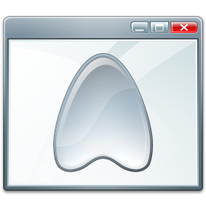
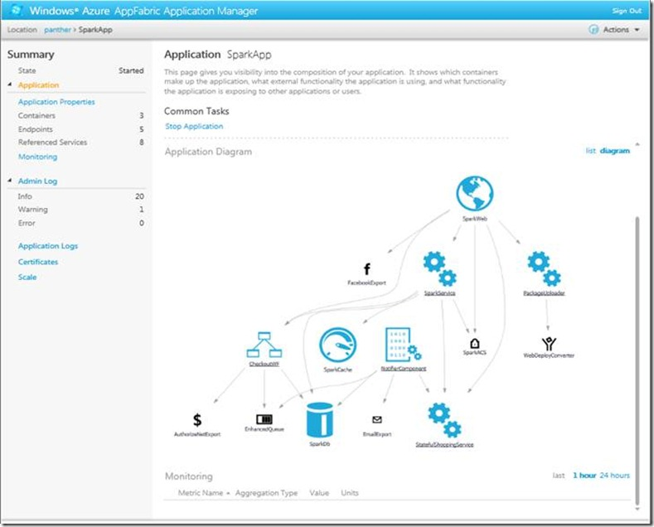
Applications
http://blogs.msdn.com/b/appfabric/archive/2011/06/20/introducing-windows-azure-appfabric-applications.aspx
Notes:
Built for WF and WCF

Slide 95

Service Bus
Site 1
Composite Application
Web Services
Azure Service Bus
Site 2
Site 3
Enterprise Service Bus
Composite Application
Web Services
Notes:
Relaying means it serves as a bus for on-premise installations wanting to talk to each other

Slide 96
Queues
Real queues – MSMQ style
Can have up to 5 GB of data in the queue
Explicit acknowledging of messages in queue
Anything that is serializable can go in

Slide 97
Topics
Queues with subscriptions
Subscribers define queries or filters
Message complete when all subscribers in a topic has processed message

Slide 99

Monitoring

Slide 100

Debugging
No debugging in the Cloud
Instrument your application using Trace, Debug
DiagnosticMonitorTraceListener
Use Diagnostics API to Configure and Collect
Event Logs
Performance Counters
Trace/Debug information (logging)
Crash Dumps or Arbitrary files
Request data on demand or scheduled
Transferred into your table and/or blog storage
Everything is remotely configurable
Notes:
By default, a new trace listener is hooked up to your worker and web roles. This captures your standard trace and debug statements and spools the data locally. At any time, you can request a transfer, which will put the information in table storage where you can query it out and analyse.
You can get hold of any of the following information: event logs, performance counters, tracing, iis logs, failed request logs, crash dumps, or any arbitrary log file your app might be using.

Slide 101
Intellitrace
If you can, use it only in Dev environment in the cloud – staging or similar
Turns off auto restart of service
http://blogs.msdn.com/b/jnak/archive/2010/06/07/using-intellitrace-to-debug-windows-azure-cloud-services.aspx
Notes:
By default, a new trace listener is hooked up to your worker and web roles. This captures your standard trace and debug statements and spools the data locally. At any time, you can request a transfer, which will put the information in table storage where you can query it out and analyse.
You can get hold of any of the following information: event logs, performance counters, tracing, iis logs, failed request logs, crash dumps, or any arbitrary log file your app might be using.

Slide 102

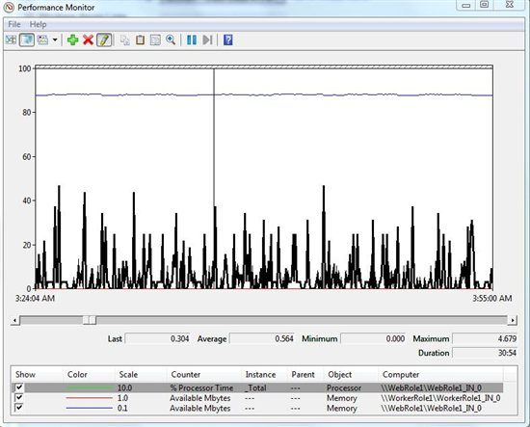
PerfMon
http://blogs.msdn.com/b/developertofu/archive/2010/08/17/announcing-the-perfmon-friendly-azure-log-viewer-plug-in.aspx

Slide 103

Miscellaneous

Slide 104
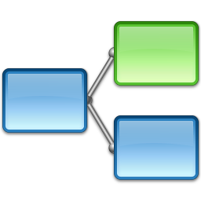
Workflow
Run on Web Role
Expose as services
Run as a dedicated Worker role
Hybrid
Host on-premise – expose through service bus
http://blogs.msdn.com/b/appfabriccat/archive/2011/01/12/running-net4-windows-workflows-in-azure-today.aspx

Slide 105
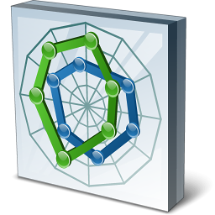
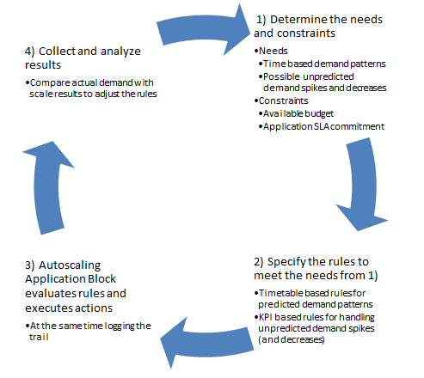
Autoscaling Application Block
http://blogs.msdn.com/b/agile/archive/2011/08/23/autoscaling-windows-azure-applications.aspx

Slide 106

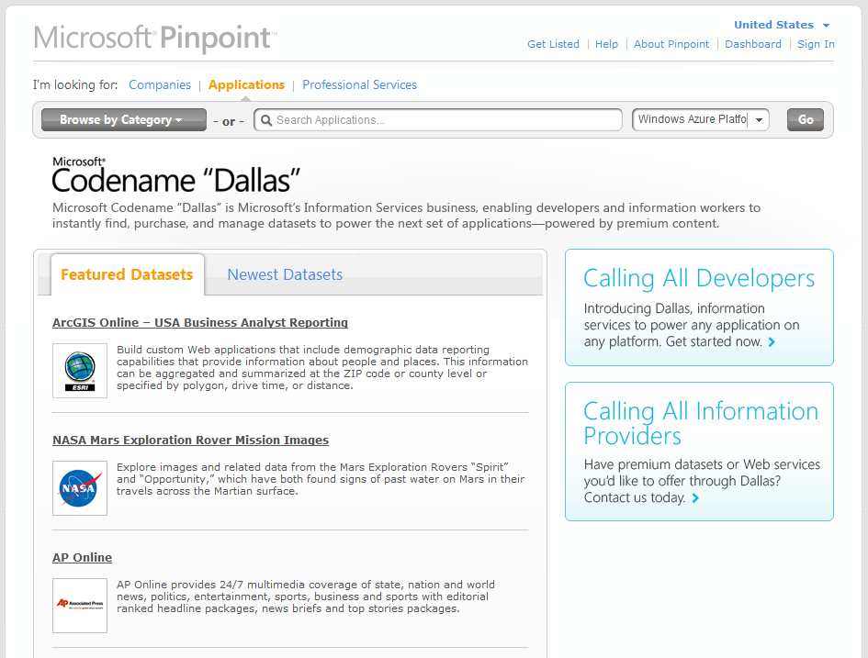
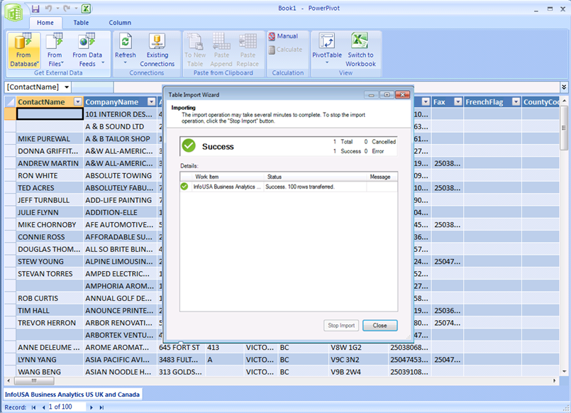
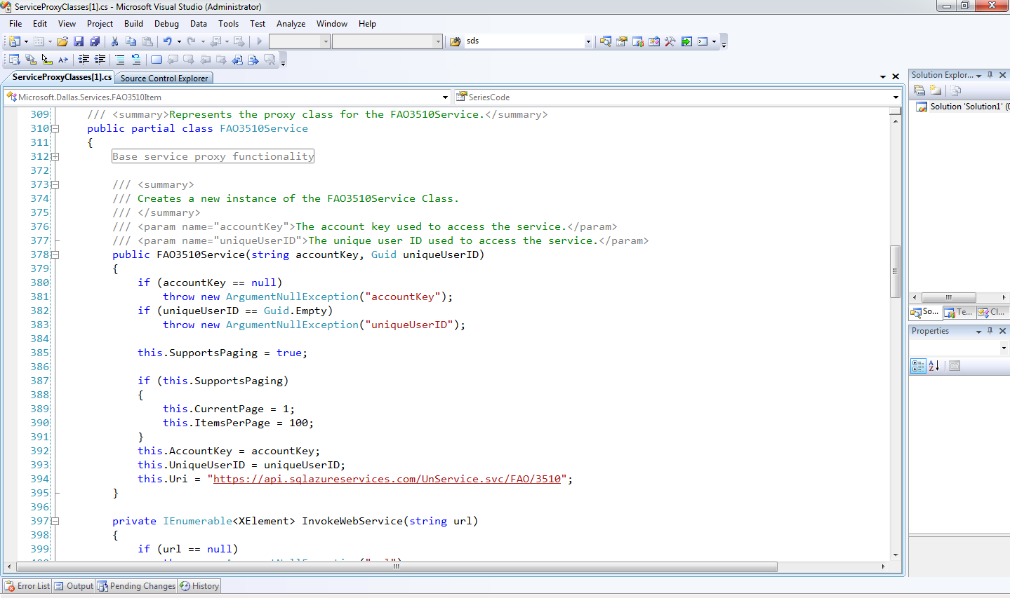
Azure Marketplace
Marketplace
Standardized APIs
Anatalytics
Reporting
Notes:
Felles API for henting av dataset
Dataset kan selges på Marketplace
Flere formater; JSON, CSV ++
Office integration
Reporting services integration

Slide 107

Coming Features
Highlights
CDN SSL Support
TFS running in Azure
http://www.msigeek.com/6387/windows-azure-roadmap-and-announcements-microsoft-pdc-2010

Slide 108

http://watoolkitwp7.codeplex.com/

Slide 109

Interoperability
“Any” platform supported
http://www.interoperabilitybridges.com/

Slide 110

Ruby
Ruby on Rails in Azure http://rubyonrails.cloudapp.net/
Connect Ruby to SQL Azure : http://sqlazureruby.codeplex.com/

Slide 111

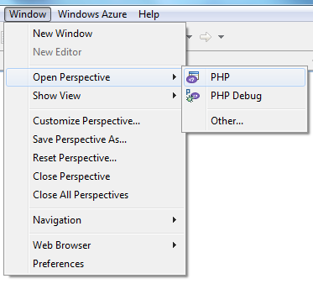
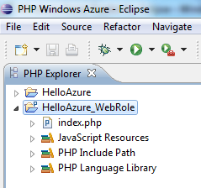
Azure for Eclipse
http://www.windowsazure4e.org/

Slide 112

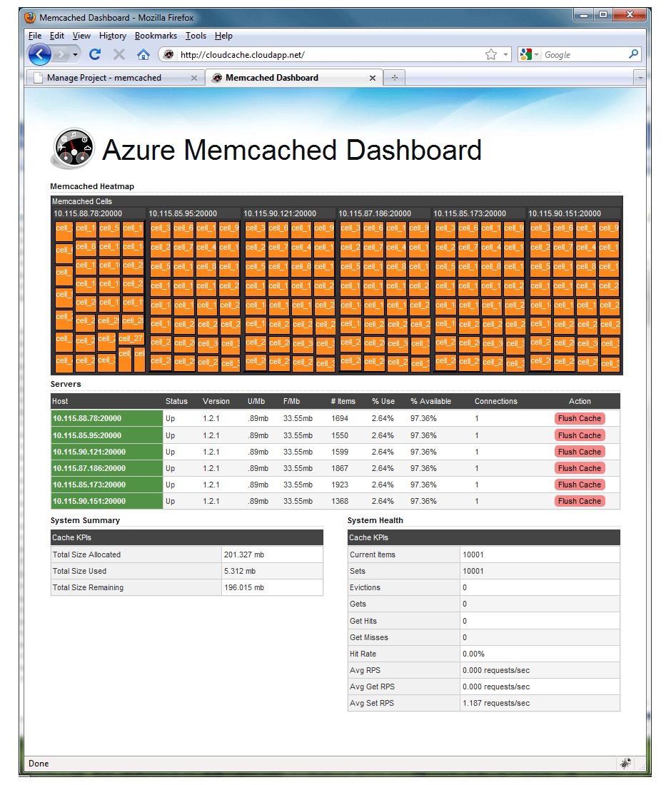
CloudCache
Distributed Caching
Memcached
http://cloudcache.codeplex.com/

Slide 113

Summary
Windows Azure is the OS for the cloud
Lets you build services without the operational worry
Designed for Scalability & Availability
Automated Service Management
Compute
Storage
Developer SDK
Utility computing - Pay-as-you-go pricing

Slide 114

Resources
Project and Presentation http://github.com/einari/gadgetshop
Windows Azure Platform http://www.azure.com/
Windows Azure Platform Training Kit http://www.microsoft.com/downloads/details.aspx?FamilyID=413E88F8-5966-4A83-B309-53B7B77EDF78&displaylang=en

Slide 115


Slide 116


Slide 117


